Slide 1
Quantifying Player Movements in Corner Kicks
Natalie and Almona

Slide 2
Goal 1
Acquire SkillCorner Data

Slide 3
So, what data do we have now?
Dataset: 7 German Bundesliga matches (2022/23 season)
2 matches from 1st division, 5 from 2nd division
207 players from 10 teams
Three data modalities:
Match information: Metadata (teams, weather, formations, player details)
Event data: 11,137 discrete events (passes, shots, fouls, etc.) with timestamps
Position data: 1,002,644 frames of x/y coordinates for all players + ball and referees (25Hz)
Official data from German Football League (DFL) using TRACAB Gen5 tracking system

Slide 4
So, what data do we have now?
Data Pre-processing Steps
XML extraction: Converted the XML files to RDS format for RStudio analysis

Slide 5
Players make different types of runs during corners

Slide 6
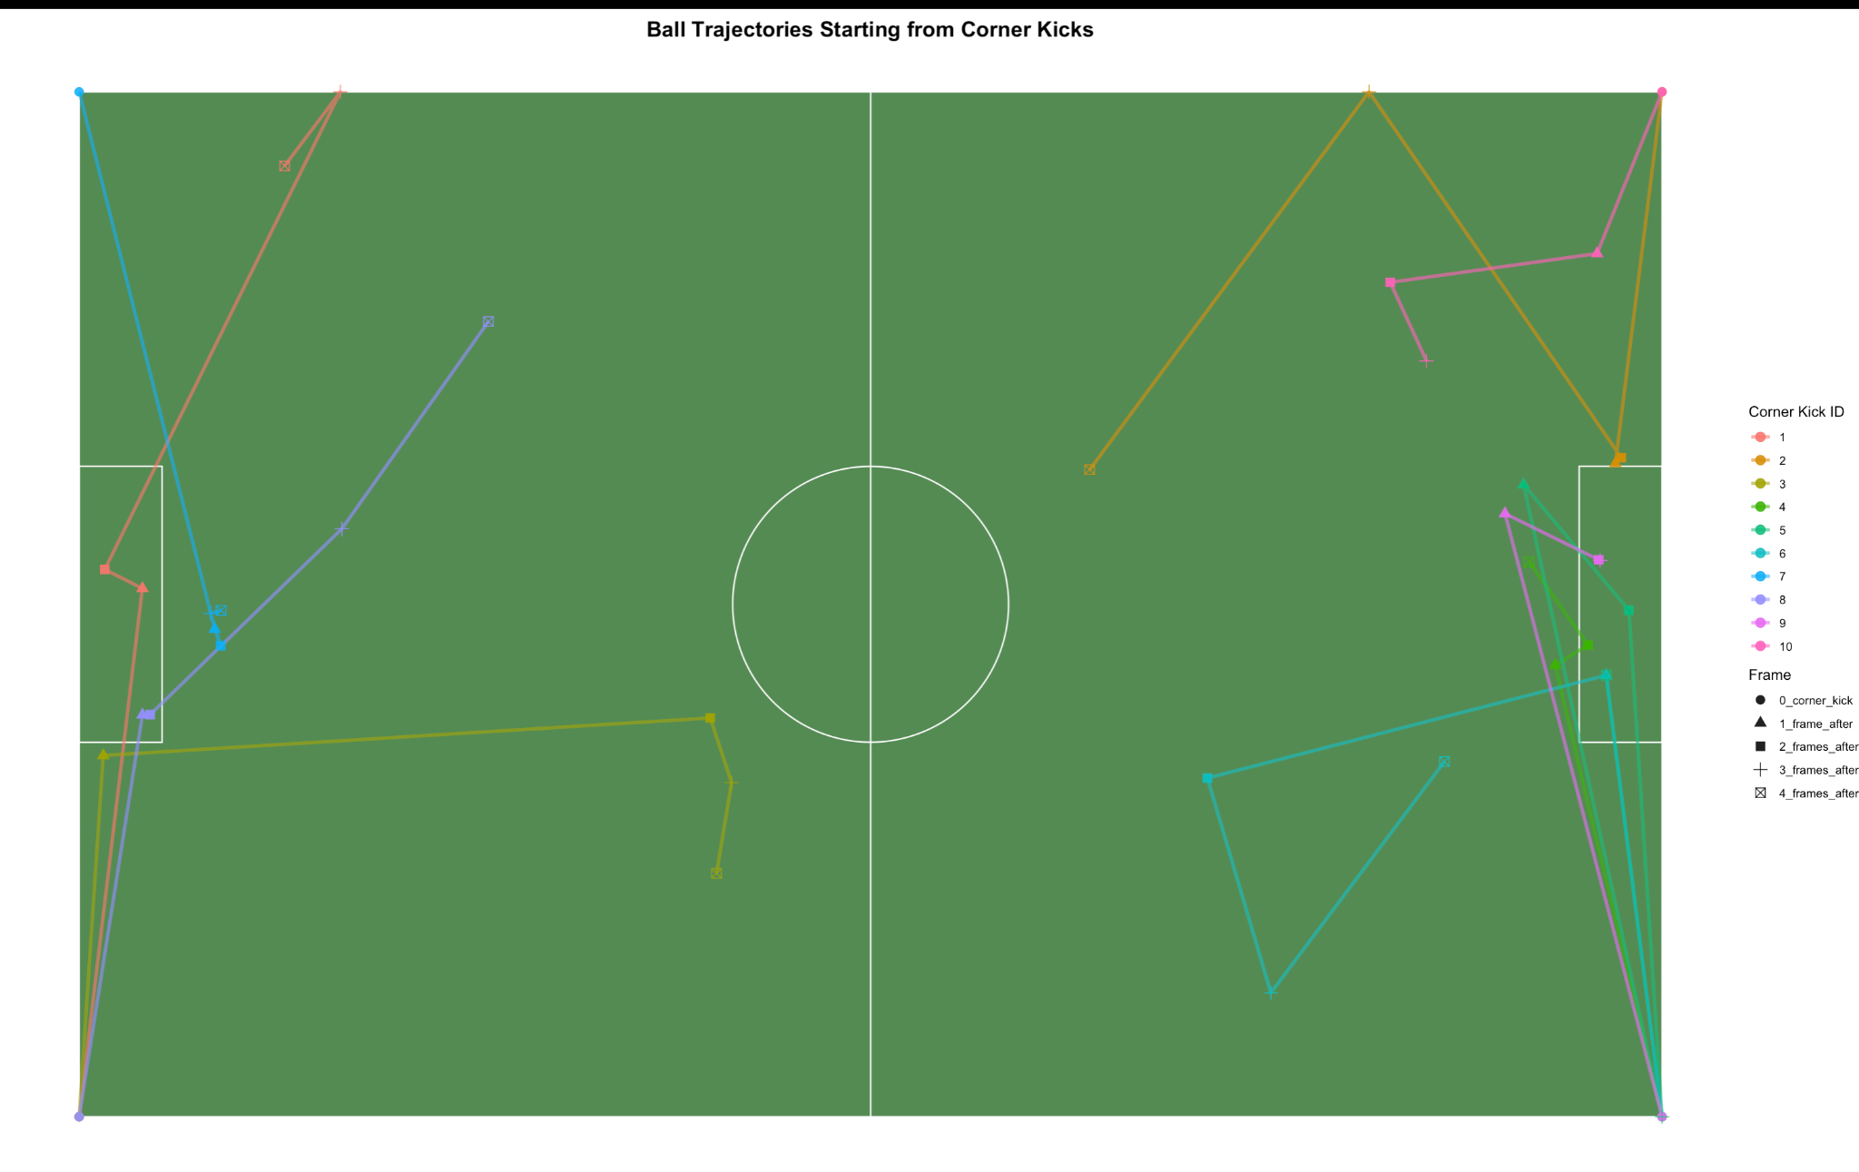
Ball Location Immediately after Corners

Slide 7
Early thoughts on methods/modeling strategy
What a successful corner kick?: getting the first touch after the corner is taken, not necessarily a shot or scoring a goal
Creating an “Open Space” metric.
Distance to marker (defender)
Speed moving away from the defender
"Losing defender" (distance between player and nearest opponent)
Gravitational Pull: how much a player attracts defenders, creating space for teammates.
Blocks
Frequency of run types by position or teams
Clustering analysis to identify common movement patterns
**Voronoi diagrams or convex hulls for "space creation"

Slide 8
Plan of Action
Hopefully get our actual data soon
Possibly look into StatsBomb data
Maybe look at Free Kicks, instead of Corner Kicks
Talk to Quang and Dr. Yurko about getting the best out of tracking data

